Slide 1

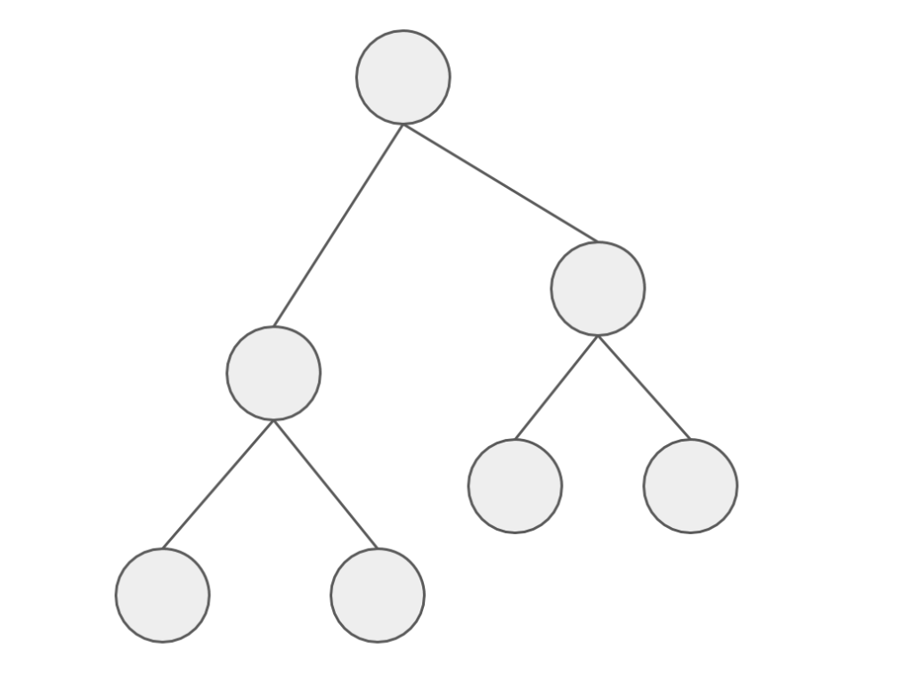
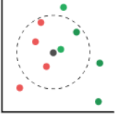
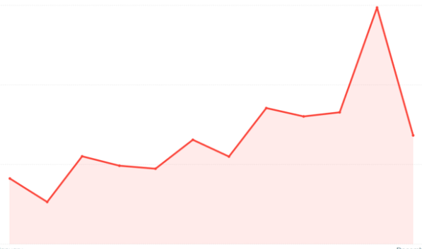
Price Predictor Regression Models
Random Forest
LGBM
KNN
Facebook Prophet
Notes:
To predict prices, we decided to use the Random Forest & LGBM Regressor methods to determine which features are the most important to price an AirBNB.
We then use the KNN Regressor to see how the price is affected with having listings close to your area.
Finally, we used the Facebook Prophet to how prices are affected by time & seasonality to predict Airbnb future prices.

Slide 2
Database Transformation
Listings Masters
Borough ID
Neighbourhood ID
Room Type ID
Yearly Rates
Monthly Rates
Day of Week Rates
Predicted Rates
EXISTING
NEW
Notes:
Before we actually run the model, we have to clean the database by adding certain information that may add value to our findings.
So we added the amenities count column because we believe that it has a positive correlation to the listing price.

Slide 3
Model Data Cleaning – Adding Columns
How will this new feature will impact the price?
amenities
[“Wifi”, “Kitchen”, “Heating”, “Air Conditioning]
amenities_count
4
Notes:
Before we actually run the model, we have to clean the database by adding certain information that may add value to our findings.
So we added the amenities count column because we believe that it has a positive correlation to the listing price.

Slide 4
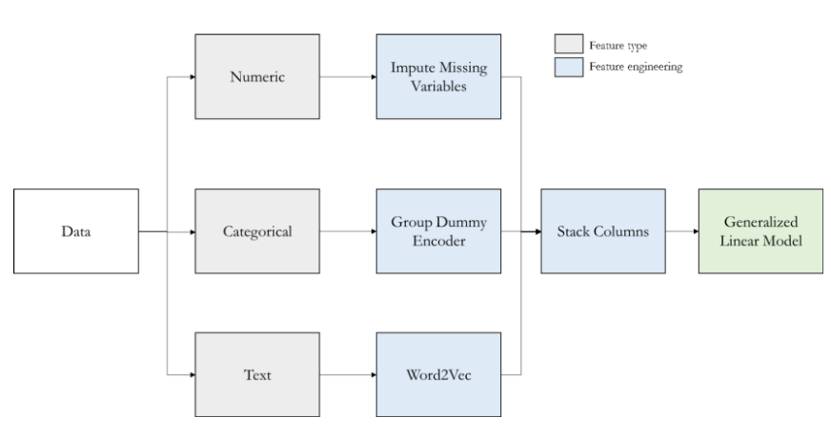
Model Data Transformation – RF, LGBM, KNN
Note: Used for Random Forest, LGBM and KNN Regressor Models only
Notes:
This table provides an overview of what we need to do to try to find the best fit for the model. The next few slides will provide a breakdown of what we did to transform the data.

Slide 5
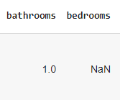


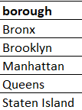
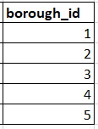

Model Data Transformation - RF, LGBM, KNN
1. Imputing Missing Numerical Data
2. Encoding Categorical Data
3. Vectorizing Text Data
Notes:
First, we needed to replace the blank fields with the averages for that specific column
Second, we need to put the data by categorize our data by numerical values which was done from our last project for boroughs, neighbourhoods & room type.
Then we also, vectorize the most important amenities to get a count for each listing.

Slide 6
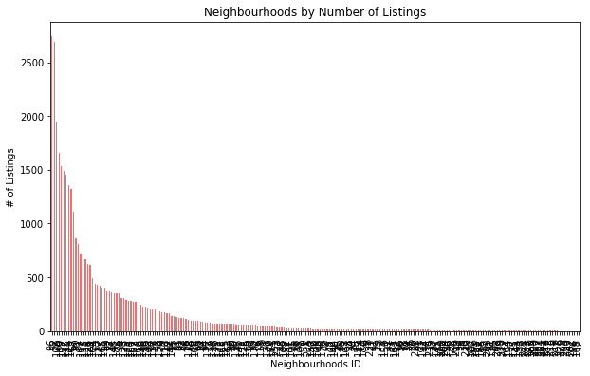
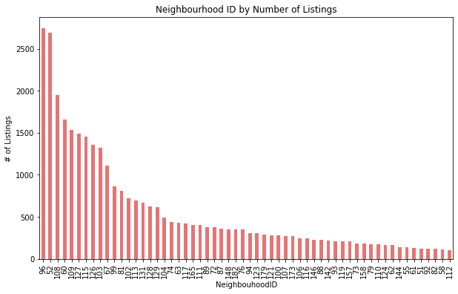
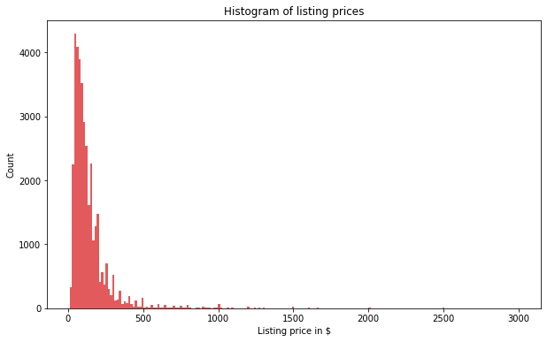
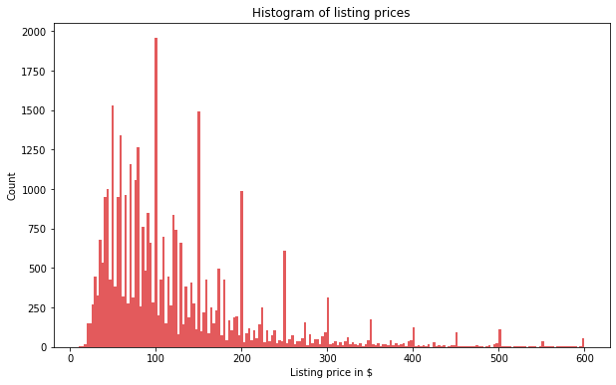
Model Data Transformation - RF, LGBM, KNN
4. Removing Outliers
Filter for:
1. ≥100 Listings
2. ≤ $600/night
Notes:
To get the best selection of listings that best represents NYC Airbnb market, 2e filtered out the outliers by only keeping the neighbourhoods that with over 100 listings & the listing prices under $600 so it is more normally distributed.

Slide 7
Model Data Transformation – FB Prophet
Prophet Model Datasets
Listings Masters
Historical Rates
Holiday Dates
Existing
New
Notes:
The facebook prophet runs differently than the other regressor model, so we need to create another dataset for this.
We used our existing data to find the listings masters data to get the borough and room type.
Then we need to created new datasets to find all the historial rates & holiday dates from 2017-2021. All this information is found on the inside Airbnb & us holiday calendar website.
Various methods like concatenation, filtering, merging, renaming columns and calculating the mean were used in Pandas to get our Final output
We believe that putting all of this together can help us accurately predict prices based on location, size, trends and seasonality.

Slide 8
Model Data Preprocessing
RF, LGBM, KNN Regressors
X-value of features listed below that may have the most impact y-value of the listing price
Change test data from 25% to 35% to provide more data to increase accuracy of the models.
Scale the X-values for normalizations to ensure all features are the same unit.
FB Prophet
Add the holiday features, borough and room type information to predict prices.
Notes:
The next step is that we need to select the right features that impact the price. We collectively agreed that features like location, the room type, # of bedrooms/bathrooms, amenities count are some of the major driving force that impacts what the hosts charge for their Airbnb.
find the optimal train-test data split and to normalize the X-values so that they are in the same units for the model to produce to correct results.

Slide 9
Model Feature Selection
X-value of features listed below that may have the most impact y-value of the listing price:
Neighbourhood
Host Identity Verified
Host Listing Counts
Super Host Listings
Room Type
Number of People that the Listing can Accommodate
Number of Amenities Provided
Number of Bathrooms
Number of Bedrooms
Number of Beds
Amenities like Heating, Parking Dryer, Daily Essentials, Kitchen etc
Minimum Nights to be Booked
Number of Reviews
Review Score Ratings
Notes:
We have collectively gone through the feature selection process to determine which features we feel that will have the most impact on the listing price.

Slide 10
Model Results
Notes:
We changed the default settings of the test data from 25% to 35% so that will have more data to give a more realistic results of predicting prices.
We need to scale the data to the same units so differences won’t be distorted. If this is not done, the test results will have major fluctuations.

Slide 11
Running the model
Notes:
-To help users explore all listings available in NYC, we created a marker cluster map using Leaflet.
-The clusters display the number of listings with the different boroughs and neighbourhoods in NYC.
-In this example, we selected the the well-known New York borough of Manhattan, and then further zoomed in to the Upper West Side neighbourhood.

Slide 12
Model Challenges
Notes:
-To help users explore all listings available in NYC, we created a marker cluster map using Leaflet.
-The clusters display the number of listings with the different boroughs and neighbourhoods in NYC.
-In this example, we selected the the well-known New York borough of Manhattan, and then further zoomed in to the Upper West Side neighbourhood.

Slide 13
Model Findings – Price Correlation
Notes:
-To help users explore all listings available in NYC, we created a marker cluster map using Leaflet.
-The clusters display the number of listings with the different boroughs and neighbourhoods in NYC.
-In this example, we selected the the well-known New York borough of Manhattan, and then further zoomed in to the Upper West Side neighbourhood.

Slide 14
Model Findings – Features
Notes:
-To help users explore all listings available in NYC, we created a marker cluster map using Leaflet.
-The clusters display the number of listings with the different boroughs and neighbourhoods in NYC.
-In this example, we selected the the well-known New York borough of Manhattan, and then further zoomed in to the Upper West Side neighbourhood.

Slide 15
Model Findings – Nearest Neighbour
Notes:
-To help users explore all listings available in NYC, we created a marker cluster map using Leaflet.
-The clusters display the number of listings with the different boroughs and neighbourhoods in NYC.
-In this example, we selected the the well-known New York borough of Manhattan, and then further zoomed in to the Upper West Side neighbourhood.

Slide 16
Model Findings – Trends & Seasonality
Notes:
-To help users explore all listings available in NYC, we created a marker cluster map using Leaflet.
-The clusters display the number of listings with the different boroughs and neighbourhoods in NYC.
-In this example, we selected the the well-known New York borough of Manhattan, and then further zoomed in to the Upper West Side neighbourhood.

Slide 17
Results
Notes:
-To help users explore all listings available in NYC, we created a marker cluster map using Leaflet.
-The clusters display the number of listings with the different boroughs and neighbourhoods in NYC.
-In this example, we selected the the well-known New York borough of Manhattan, and then further zoomed in to the Upper West Side neighbourhood.

Slide 18
Next Steps…
A major area of concern for cities worldwide is the effect that expansion of Airbnb has made on the housing market for indigenous residents.
Further analysis can help determine if there is a correlation between Airbnb listings and rental/house prices for NYC neighbourhoods.

